Slide 1


Slide 2

DEVELOPED BY:
M.MADHURI (2200520293)
Y.APOORVA (2200520265)
D.SANJANA (2200520293)
COURSE:
OBJECT ORIENTED PROGRAMMING(22CA1207)
SUBMITTED TO:
VENKATA RAMANA SIR

Slide 3

SCOPE OF THE PROJECT:
The requirement of the user is to
Access or search information.
Login to the system through the first page of the application.
Change the password after logging in to the system.
View / change his/her details.
Can get help through the”HELP” option to view different features of the system.
Students can give feedback on college/staff/any other student.
An admin login should be present who can read as well as remove any uploads.

Slide 4

BRIEF ON PROJECT:
The college management system helps Educational Institutions especially colleges in various ways, such as storing data, maintaining student profiles, analyzing administrative and academic data, improving communication, and engaging students.
There are several college ERP software’s that’s available in the market to streamline administrative processes.
The world is rapidly changing and technology has to meet the expectations of the new age learners.
Students of this generation rely on technology to update themselves on a regular basis.
Giving them a seamless experience of transitioning from the real to the digital world and vice versa is imperative .
A college management system is cloud-based education management software that enables colleges & higher education institutions to manage their academic and administrative operations, like admission, student enrollment, student attendance, online fees, grades, assignments, examinations, and all other tasks.
The college ERP is a technologically advanced and robust software application that is created to track and manage all college activities including student admissions, attendance, fee payments, human resources, hostel management, bus management, and others.

Slide 5
User Interface of College Management System
This is one of the main tasks of the developer to design such an interface that user can use it easily in one word
It should be user friendly and for this you should have a better understanding of the audience which going to use this application,
Initially we need the targeting people that was kind of application do they need
After getting all the information we should start to design the application.

Slide 6
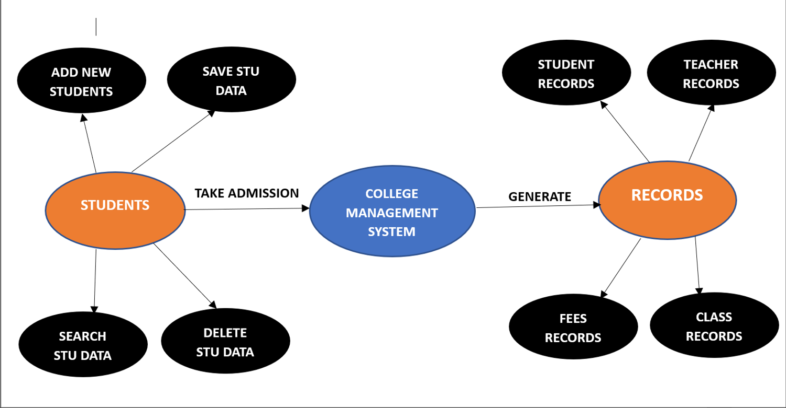

Slide 7
Course Management
Student Management
Faculty Employee Management
College management system
Faculty Management
System User Management
Login Management

Slide 8
Drawbacks of College Management System
This process is time consuming
There is a threat to the record of the students and teachers , in this case there might be a chance that a person makes entry on someone else record
There is no proper way of getting to know about the events and extra curriculm activities happening in colleges
It might be the case that student tries to bribe the teachers to avoid the long queue

Slide 9

CLASSES AND METHODS IN COLLEGE MANAGEMENT SYSTEM:
CLASSES AND METHODS:
CLASS: College Management
METHODS:Open()
CollegeDetails()
CLASS:Department
METHODS:DepartmentDetails()
ShowEvents()
CLASS:Student
METHODS:StudentDetails()
PayFees()
CLASS:Staff
METHOD:StaffDetails()
CLASS:Library
METHODS:LibraryDetails()
BusDetails()

Slide 10

CODE:
import java.util.ArrayList;
import java.util.List;
import java.util.Scanner;
class Student {
private String name;
private int rollNumber;
public Student(String name, int rollNumber) {
this.name = name;
this.rollNumber = rollNumber;
}
public String getName() {
return name;
}
public int getRollNumber() {
return rollNumber;
}
}
class College {
private String name;
private List<Student> students;
public College(String name) {
this.name = name;
students = new ArrayList<>();
}
public void addStudent(Student student) {
students.add(student);
}
public void displayStudents() {
System.out.println("Students in " + name + ":");
for (Student student : students) {
System.out.println("Name: " + student.getName() + ", Roll Number: " + student.getRollNumber());
}
}
}

Slide 11

public class CollegeManagementSystem {
public static void main(String[] args) {
Scanner scanner = new Scanner(System.in);
College college = new College("ABC College");
boolean running = true;
while (running) {
System.out.println("College Management System Menu:");
System.out.println("1. Add Student");
System.out.println("2. Display Students");
System.out.println("3. Quit");
System.out.print("Enter your choice: ");
int choice = scanner.nextInt();
switch (choice) {
case 1:
System.out.print("Enter student name: ");
String name = scanner.next();
System.out.print("Enter student roll number: ");
int rollNumber = scanner.nextInt();
Student student = new Student(name, rollNumber);
college.addStudent(student);
System.out.println("Student added successfully!");
case 2:
college.displayStudents();
break;
case 3:
running = false;
break;
default:
System.out.println("Invalid choice. Please try again”); }
System.out.println();
}
System.out.println("Exiting College Management System.");
}
}

Slide 12
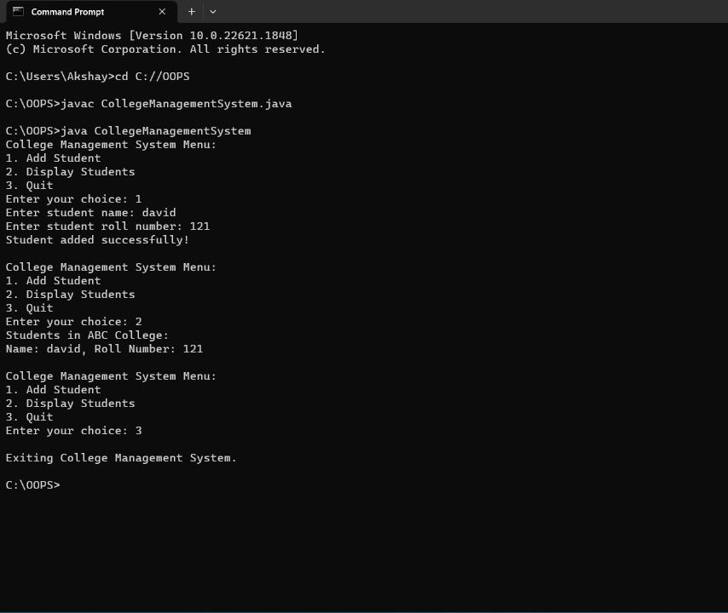

OUTPUT:

Slide 13

ROLES AND RESPONSIBILITIES OF TEAM MEMBERS :
APOORVA :
SANJANA :
Helps project team solve equipment management problems
Communicating with the project manager about roadblocks
Managing deliverables according to the plan
Allocate and Schedule the right resource within the project timeline and budget
Gather technical requirements from team members
Documents and analyze project requirements

Slide 14

MADHURI :
Creating project plan and schedule
Managing the project Schedule
Managing all project deliverables
Creating project vision
Recruting project staff
Communicating with upper management
And other stakeholders
Leading and managing project team

Slide 15



Slide 16


